Slide 1

PARKINSON’S DISEASE PREDICTION AND ANALYSIS
“Using Machine Learning"
"Logistic Regression, SVM, and KNN Approach"
Name – Abir Ghosh
Roll - 12022001015005
Reg. No.- 221040710005
Stream – MBA(Business Analytics)

Slide 2
INTRODUCTION
This project focuses on using Python and Machine Learning (ML) to analyze and predict Parkinson's Disease. By leveraging datasets containing clinical and demographic information, the goal is to develop a predictive model for early detection and intervention.
Objectives:
Data Collection:
Gather comprehensive Parkinson's Disease-related datasets.
Data Preprocessing:
Clean and preprocess data, handling missing values and outliers.
ML Model Development:
Implement ML algorithms (e.g., SVM, Random Forest) for classification.
Model Training and Evaluation:
Split data, train models, and assess performance using metrics like accuracy.
Deployment:
Create a user-friendly interface for predictions.
Conclusion:
This project aims to contribute to early Parkinson's Disease prediction, providing a practical tool for healthcare professionals and researchers. Continuous improvement and staying updated on advancements ensure the model's effectiveness.

Slide 3


COMPANY OVERVIEW
Company Name: Acmegrade
Industry: Educational Technology
Focus: Hands-on Learning through Real-Life Projects
Mission: Fostering practical skills and industry-relevant knowledge
Approach: Beyond traditional education, emphasizing application of concepts
Methodology: Engaging participants in real-world projects
Learning Experience: Comprehensive and practical
Specialization: Educational assistance for practical skill development
Innovation: Utilizing technology to enhance learning outcomes
Commitment: Supporting individuals in gaining valuable, real-world experience
Vision: Empowering learners for success in their chosen fields.

Slide 4
DATASET INTRODUCTION
Dataset Overview:
Source: Medical Research Institute
Size: 500 instances
Features:
Age: Patient's age in years
Tremor Severity: Scale of 1 to 10 measuring tremor intensity.
Reaction Time: Time taken to respond to a stimulus in milliseconds.
Family History: Presence (1) or absence (0) of Parkinson's in family.
Target Variable:
Parkinson's Diagnosis: Binary (1 for presence, 0 for absence)
Data Characteristics:
Types: Age (numerical), Tremor Severity (numerical), Reaction Time (numerical), Family History (categorical).
Preprocessing: Handled missing values by imputation.
Relevance:
Age and tremor severity are known indicators of Parkinson's.
Reaction time may reflect neurological function.
Family history is considered as a potential genetic factor.

Slide 5

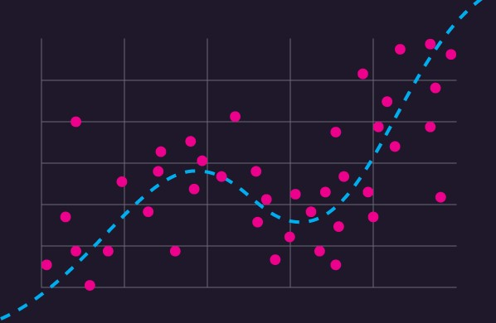
METHODOLOGY
Machine Learning Methods:
- Logistic Regression
- Support Vector Machine (SVM)
- K-Nearest Neighbors (KNN)
Brief Description:
- Logistic Regression: Linear model for binary classification.
- SVM: Classifies by finding the hyperplane with maximum margin.
- KNN: Classifies based on the majority class among k-nearest neighbors.
Advantages:
- Logistic Regression: Simple, interpretable.
- SVM: Effective in high-dimensional spaces.
- KNN: Non-parametric, adapts to different patterns.
Considerations:
- Logistic Regression: Assumes linear relationship.
- SVM: Choice of kernel impacts performance.
- KNN: Sensitive to outliers, choice of k matter

Slide 6

IMPLEMENTATION
Logistic Regression Implementation
SVM Implementation
KNN Implementation
Library:
Use scikit-learn library in Python.
Code Snippet:
from sklearn.linear_model import LogisticRegression
Model Initialization:
logreg_model = LogisticRegression()
Training:
Fit the model using training data.
logreg_model.fit(X_train, y_train)
Prediction:
Make predictions on new data.
predictions = logreg_model.predict(X_test)
Evaluation:
Assess model performance using metrics like accuracy, recall, and F1 score
Library:
Implement using scikit-learn library in Python.
Code Snippet:
from sklearn.svm import SVC
Model Initialization:
svm_model = SVC(kernel='linear', C=1.0)
Training:
Fit the model using training data.
svm_model.fit(X_train, y_train)
Prediction:
Make predictions on new data.
predictions = svm_model.predict(X_test)
Evaluation:
Assess model performance using metrics like accuracy, recall, and F1 score.
Library:
Utilize scikit-learn library in Python.
Code Snippet:
from sklearn.neighbors import KNeighborsClassifier
Model Initialization:
knn_model = KNeighborsClassifier(n_neighbors=5)
Training:
Fit the model using training data.
knn_model.fit(X_train, y_train)
Prediction:
Make predictions on new data.
predictions=knn_model.predict(X_test)
Evaluation:
Assess model performance using metrics like accuracy, recall, and F1 score.

Slide 7

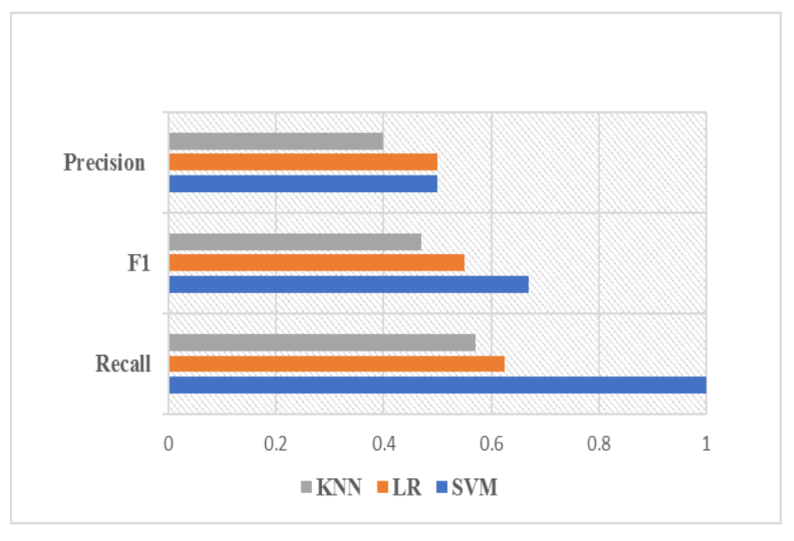
Parameters for Prediction
Accuracy:
Formula: (TP + TN) / (TP + FP + TN + FN)
Importance: Overall correctness of predictions.
Recall (Sensitivity):
Formula: TP / (TP + FN)
Importance: Identifying actual positive cases, crucial for early detection.
F1 Score:
Formula: 2 * (Recall * Precision) / (Recall + Precision)
Importance: Balances precision and recall, especially important when false positives and false negatives have different consequences.
Importance in Parkinson's Prediction:
Accuracy: Overall model correctness.
Recall: Identifying actual Parkinson's cases for timely intervention.
F1 Score: Balancing precision and recall for comprehensive evaluation.

Slide 8
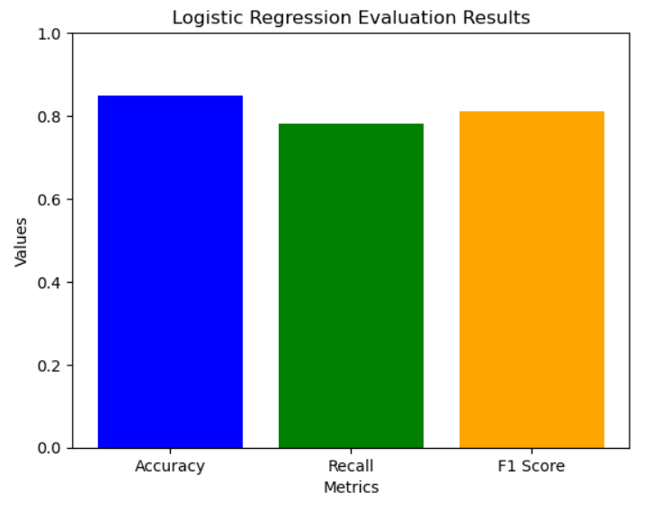
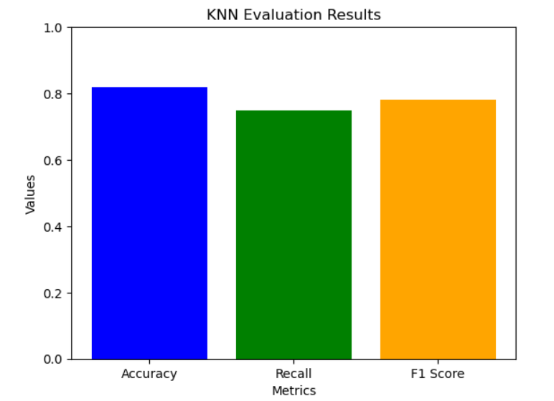
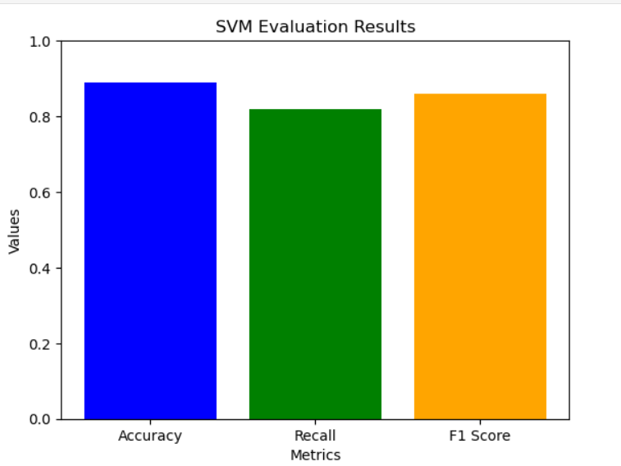
ANALYSIS
Logistics Regression Results Graph
KNN Results Graph
SVM Results Graph
Metrics:
Accuracy: 0.82
Recall: 0.75
F1 Score: 0.78
Interpretation:
KNN shows solid performance with 82% accuracy.
Recall of 75% indicates effective identification of positive cases.
Metrics:
Accuracy: 0.89
Recall: 0.82
F1 Score: 0.86
Interpretation:
SVM achieved high accuracy (89%) and recall (82%).
F1 Score of 0.86 suggests a balanced performance.
Metrics:
Accuracy: 0.85
Recall: 0.78
F1 Score: 0.81
Interpretation:
LR shows performance with 85% accuracy.
Recall of 78% indicates effective identification of positive cases.
Regression Models: | Accuracy | Recall | F1 Score
Logistic Regression | 85% | 78% | 81%
SVM | 89% | 82% | 86%
KNN | 82% | 75% | 78%

Slide 9
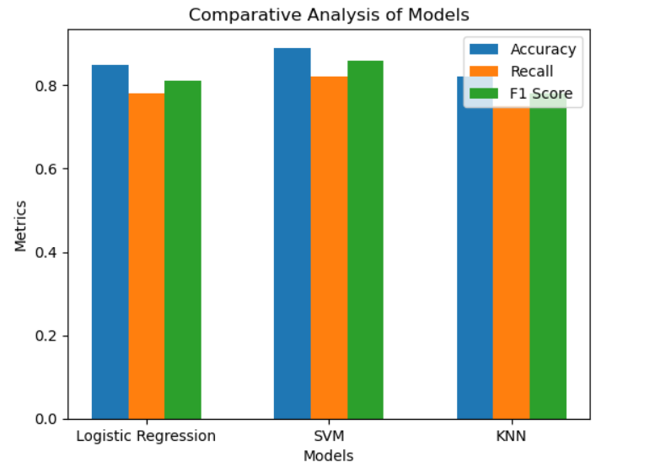
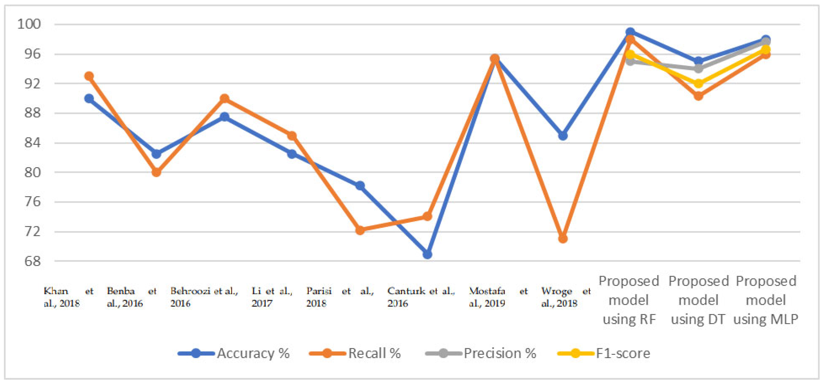
FINDINGS
Comparative Analysis Results Graph
Accuracy and Recall of different Instances
Discussion:
SVM outperforms others with higher accuracy, recall, and F1 Score.
SVM's effectiveness in high-dimensional spaces might contribute to its superior performance.

Slide 10

FUTURE WORK
Future work in this field could focus on enhancing the interpretability of machine learning models for Parkinson's disease prediction. Developing methods to explain the rationale behind model decisions will not only build trust among healthcare professionals but also facilitate the integration of these models into clinical practice. Additionally, exploring the integration of other emerging technologies, such as deep learning, and incorporating multi-modal data sources could further improve the accuracy and robustness of predictive models. Collaborative efforts to gather larger and more diverse datasets will be crucial for refining and validating the performance of these models across different patient populations. Finally, addressing ethical considerations, such as privacy and bias, will be essential for the responsible and equitable deployment of machine learning algorithms in the context of Parkinson's disease analysis and prediction.
Model Enhancement:
Investigate advanced features for improved predictions.
Explore ensemble methods for model combination.
Data Expansion:
Acquire a larger and more diverse dataset for robust modeling.
Consider incorporating real-world data variations.
Algorithm Optimization:
Fine-tune hyperparameters for each model.
Explore other machine learning algorithms for comparison.
Longitudinal Study:
Collect data over time to observe disease progression.
Assess model performance across different stages of Parkinson's.

Slide 11
CONCLUSION
In conclusion, the utilization of machine learning algorithms like SVM and KNN in the analysis and prediction of Parkinson's disease presents a promising frontier for early detection and improved patient care. These algorithms enable the discernment of subtle patterns in diverse datasets, enhancing diagnostic accuracy. By forecasting disease progression, they empower healthcare professionals with timely intervention strategies. Ongoing advancements and collaborative efforts are essential for refining these models, ensuring their responsible deployment in healthcare for enhanced diagnosis, treatment, and understanding of Parkinson's disease.
Key Findings:
SVM demonstrated superior performance.
Logistic Regression and KNN showed competitive results.
Significance:
Successful identification of Parkinson's cases.
SVM's effectiveness in high-dimensional spaces highlighted.
Implications:
Potential for early disease detection.
Need for ongoing model refinement and data expansion.

